Slide 1
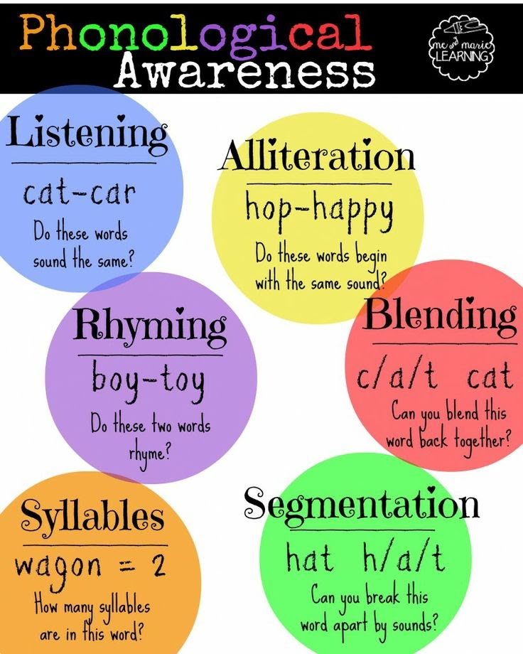
Phonemic awareness
.
phonemic awareness is the ability to identify and manipulate sounds. Phonemes blend together to form words, and every word we use is made up of a combination of them.
These sounds blend together to form words.If you change any letter in a word, though, you change everything! For example, take the word “rag.” If the first sound, or phoneme, of the word is changed to a “b,” then you’re left with an entirely new word (bag) with its own distinct meaning.
Phonemic awareness is one of the first skills your child will need in their toolbelt for reading, which, of course, is an important part of learning. It’s also one of the first steps to building their confidence with sounds (and, later, words!).

Slide 2
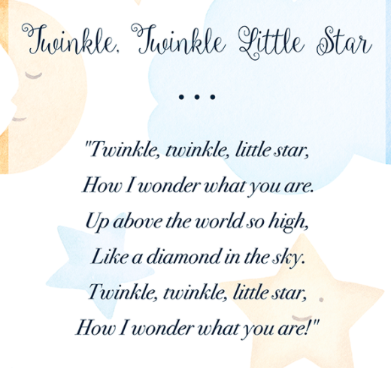
Rhyming
What words rhyme?
When the blazing sun is gone,
When he nothing shines upon,
Then you show your little light,
Twinkle, twinkle, all the night.
Twinkle, twinkle, little star,
How I wonder what you are!
Then the traveler in the dark
Thanks you for your tiny spark;
He could not see which way to go,
If you did not twinkle so.
Twinkle, twinkle, little star,
How I wonder what you are!

Slide 3
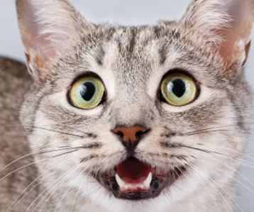

Listening
Do these words sound the same?
CAT
CAR

Slide 4
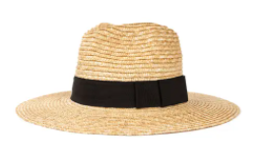
Listening
Do these words sound the same?
CAT
HAT
HAT

Slide 5
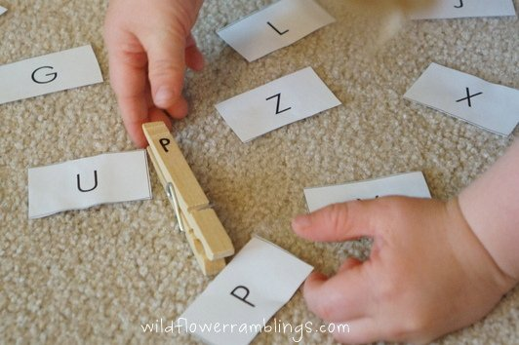
Matching Letters
Learning to recognize letters.
Materials:
Clothespins
Pieces of paper
Marker
Write letters on clothespins and on pieces of paper with a marker. Have your child match the letters on the clothespins to the letters on the pieces of paper.

Slide 6
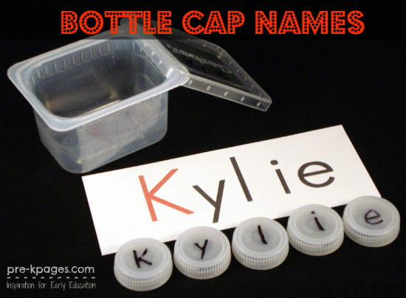
Bottle Cap Name
Learning to recognize letters.
Materials:
Bottle caps
Permanent marker
Piece of paper
Write your child’s name on a piece of paper. Then write letters on the top of the water bottle caps with a permanent marker. Have your child spell his/her name using the bottle caps.

